Slide 1




Machine Learning Basics
João Campagnolo
Computational Neuroscience class
Spring 2024

Slide 2
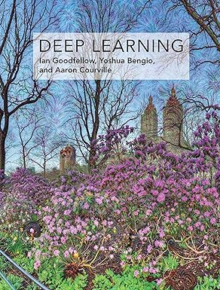
Overview & Credits
Basics of Machine learning
Types of learning
Principles of Learning
k-NN classifier, and k-means clustering
Course adapted from MLIM lectures (Prof. Raghavendra Selvan & Prof. Erik Dam)
Based on:
@book{Goodfellow-et-al-2016, title={Deep Learning}, author={Ian Goodfellow and Yoshua Bengio and Aaron Courville}, publisher={MIT Press}, note={\url{http://www.deeplearningbook.org}}, year={2016} }

Slide 3
Formalising Machine Learning
Training examples
(x1,y1), (x2,y2)...(xN,yN)
Notes:
Data points are generated according to the unknown data generating distribution 𝑃(𝑋)P(X) and are paired with their corresponding outputs according to the unknown target function 𝑓.
These pairs form the training examples (𝑥1,𝑦1),(𝑥2,𝑦2),…,(𝑥𝑁,𝑦𝑁)

Slide 4
Formalising Machine Learning
Unknown target function
f : X → Y
Unknown data generating Distribution
P(X)
Training examples
(x1,y1), (x2,y2)...(xN,yN)
Notes:
Key Goal: The main goal of machine learning is to approximate the unknown target function 𝑓 using a final hypothesis ℎ derived from the training examples.
Unknown Data Generating Distribution 𝑃(𝑋)
Definition: This is the probability distribution that generates the input data 𝑋. It represents the process or environment from which our data samples are drawn.
Example: For a spam detection system, 𝑃(𝑋)P(X) could represent the distribution of all possible emails.

Slide 5
Formalising Machine Learning
Unknown target function
f : X → Y
Unknown data generating Distribution
P(X)
Training examples
(x1,y1), (x2,y2)...(xN,yN)
Learning Algorithm
Hypothesis Set
Notes:
Learning Algorithm:
The training examples are fed into the learning algorithm.
The learning algorithm searches through the hypothesis set to find the best hypothesis that approximates the target function.
Hypothesis Set:
The learning algorithm evaluates multiple hypotheses from the hypothesis set.
It selects the hypothesis that minimizes the error on the training data (or, ideally, generalizes well to new data).

Slide 6
Formalising Machine Learning
Unknown target function
f : X → Y
Unknown data generating Distribution
P(X)
Training examples
(x1,y1), (x2,y2)...(xN,yN)
Learning Algorithm
Final Hypothesis
h
Hypothesis Set
Notes:
Inference:
The learning algorithm infers the final hypothesis ℎ based on the training data.
This final hypothesis is used to make predictions on new, unseen data.

Slide 7
Formalising Machine Learning
Unknown target function
f : X → Y
Unknown data generating Distribution
P(X)
inference
Training examples
(x1,y1), (x2,y2)...(xN,yN)
Learning Algorithm
Final Hypothesis
h
Hypothesis Set
Figure based on Fig.1.9 Mostafa et al.
Notes:
Key Goal: The main goal of machine learning is to approximate the unknown target function 𝑓 using a final hypothesis ℎ derived from the training examples.
Challenges: Since 𝑓 and 𝑃(𝑋) are unknown, the quality of the final hypothesis ℎ depends on the choice of the learning algorithm, the richness of the hypothesis set, and the representativeness of the training examples.
Inference Process: The learning algorithm's task is to infer a hypothesis ℎ that generalizes well to new data, achieving a balance between fitting the training data and maintaining simplicity to avoid overfitting.

Slide 8
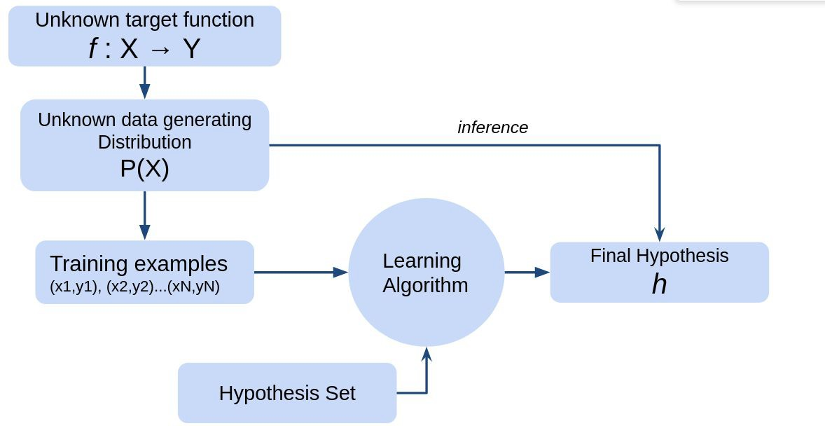
A learning algorithm
“A computer program is said to learn from experience E with respect to some class of tasks T and performance measure P, if its performance at tasks in T, as measured by P, improves with experience E.”
Mitchell, Tom M. Machine learning (1997)

Slide 9
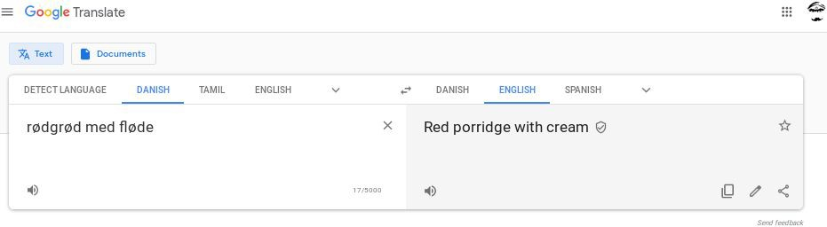
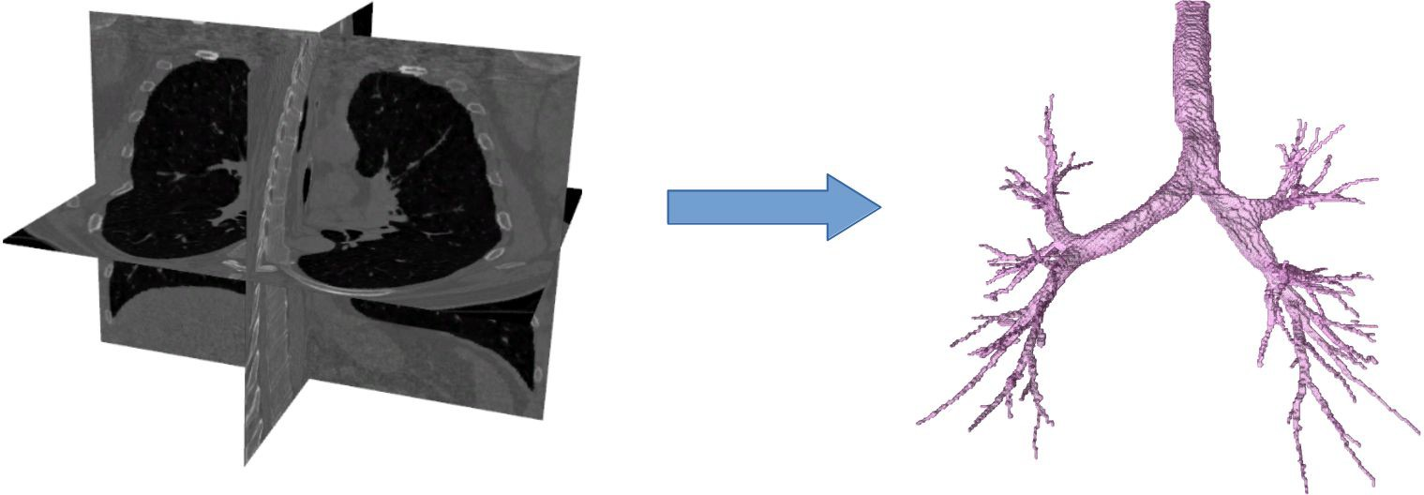
The Task, T
Classification
Regression
Transcription
Machine translation
Face recognition
Anomaly detection
Synthesis & sampling
Denoising
Density estimation
Self-driving

Slide 10
The Performance measure, P
Not always straightforward but most common:
Accuracy
Error rates/ losses (0-1 loss)
Log probability
KL divergence
https://thispersondoesnotexist.com/
http://www.thisworddoesnotexist.com/

Slide 11
The Experience, E
All the ways information can enter the model primarily as:
Prior information
Hyper-parameters
Data/ supervision
More concrete classification of ML methods is based on E

Slide 12
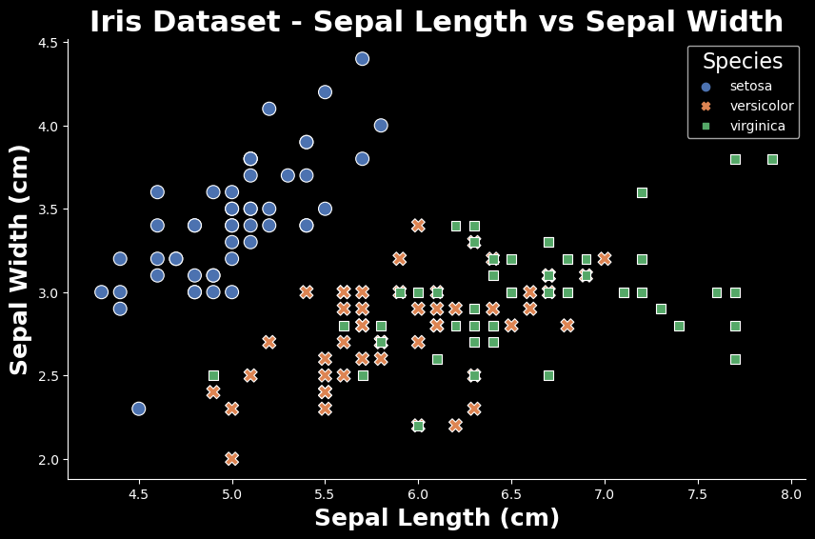
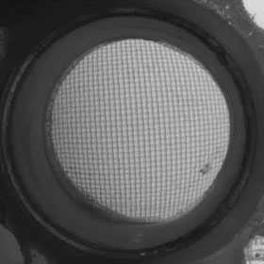
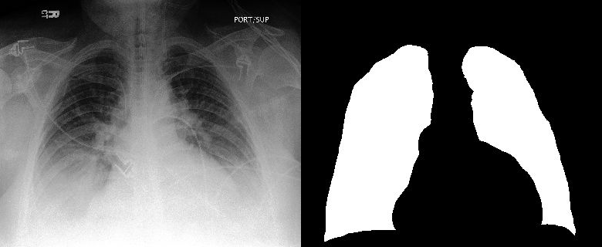
Supervised Learning
Strong labels for the entire dataset
(Relatively) Easy to train
Hard to obtain high quality labels
Ex: Image Segmentation

Slide 13
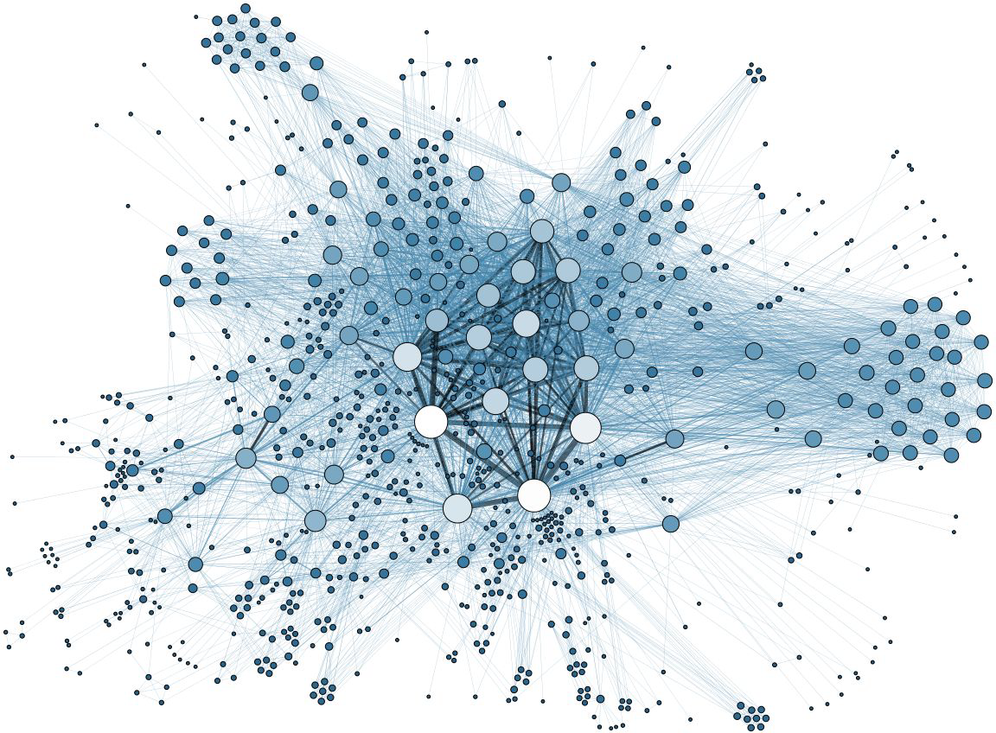
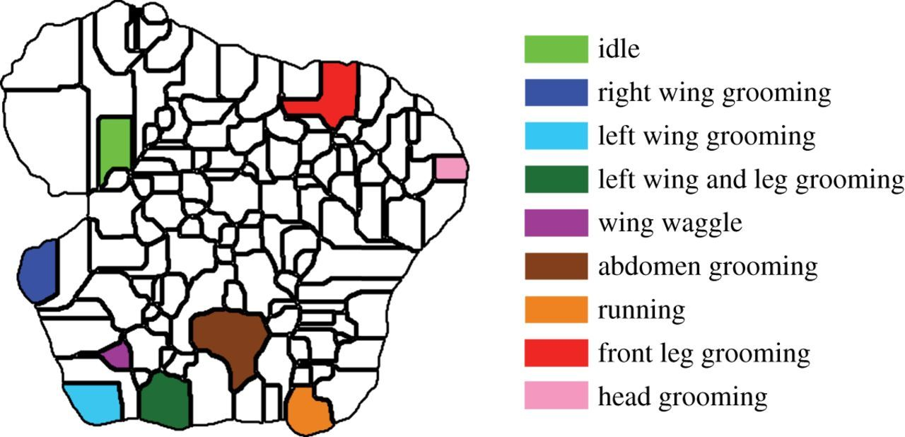
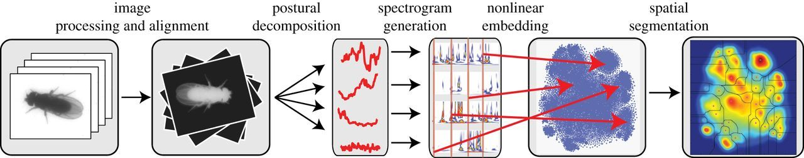
Unsupervised learning
No labels.
“Figure it out yourself” model
Ex: Social networks, Gene expression networks
Berman et al., 2014

Slide 14
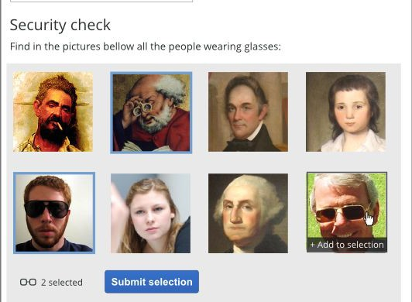
Semi-supervised learning
Strong labels for some of the data
Weak labels for all of the data
Can be useful in cases where strong labels are hard!
Ex: Captcha

Slide 15
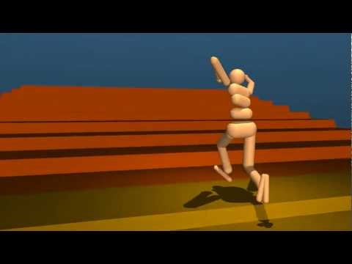

Reinforcement learning
Combination of strong and weak labels
Online learning
Constant learning
Ex: Streaming services recommendation

Slide 16
More….
Self-supervised
Active learning
Continual learning
Meta-learning
…...
We will focus on supervised and unsupervised learning methods.

Slide 17
Formulate your learning task
Task T
Performance P
Experience E
We will discuss this in the exercise session.

Slide 18
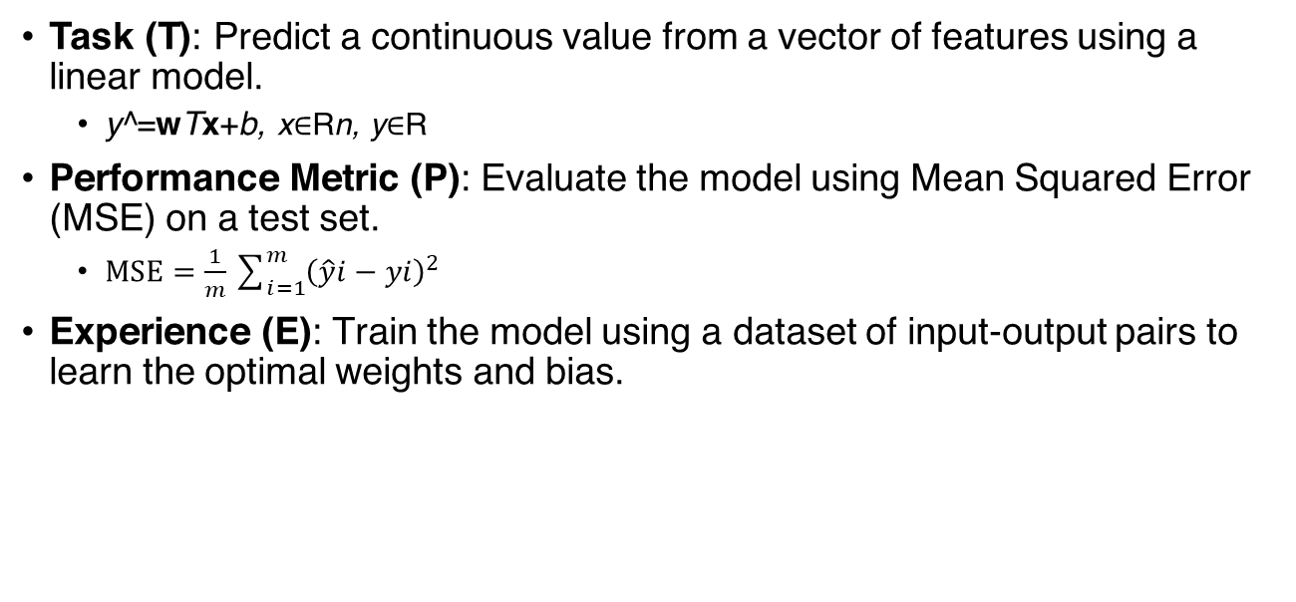
Example: Linear regression
Task (T): Predict a continuous value from a vector of features using a linear model.
y^​=wTx+b, x∈Rn, y∈R
Performance Metric (P): Evaluate the model using Mean Squared Error (MSE) on a test set.
$MSE=\frac{1}{m}\sum_{i=1}^{m}{{\left(\hat{y}i−yi\right)}^{2}}$
Experience (E): Train the model using a dataset of input-output pairs to learn the optimal weights and bias.
Notes:
The predicted value 𝑦^y^​ is given by:𝑦^=𝑤𝑇𝑥+𝑏y^​=wTx+b

Slide 19
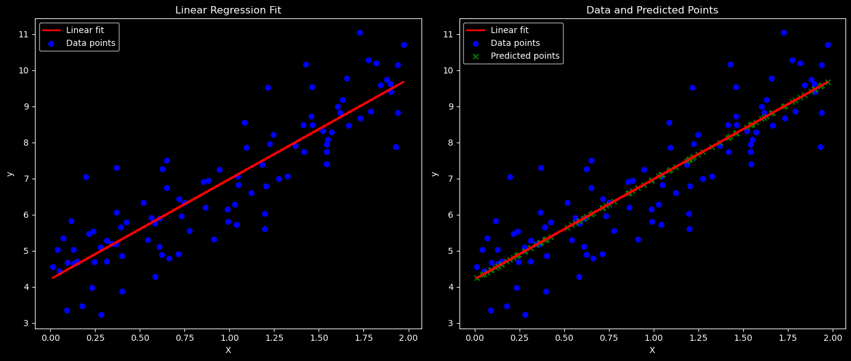
Example: Linear regression
Experience (E): Train the model using a dataset of input-output pairs to learn the optimal weights and bias.

Slide 20
Principles of Learning

Slide 21
Generalization Error
In-sample/ training error
Out-of-sample/ test error
Difference between these two is generalization

Slide 22
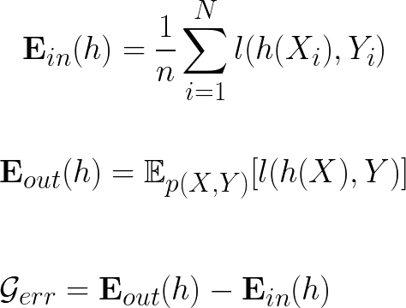
Generalization Error
Not obvious to minimize the generalization error.

Slide 23
There’s No Free Lunch
ML algorithms can generalize well from finite set of examples
Contradicts basic principles of logic!
ML avoids this using probabilistic rules
ML finds rules that are probably correct about most members

Slide 24
There’s No Free Lunch
ML algorithms can generalize well from finite set of examples
Contradicts basic principles of logic!
ML avoids this using probabilistic rules
ML finds rules that are probably correct about most members
performance
No Free Lunch Theorem: Averaged over all possible data generating distributions, every classification algorithm has the same error rate when classifying previously unobserved points (Wolpert, 1996)
classifier-1
classifier-2
data distributions

Slide 25
There’s No Free Lunch
ML algorithms can generalize well from finite set of examples
Contradicts basic principles of logic!
ML avoids this using probabilistic rules
ML finds rules that are probably correct about most members
performance
No Free Lunch Theorem: Averaged over all possible data generating distributions, every classification algorithm has the same error rate when classifying previously unobserved points (Wolpert, 1996)
classifier-1
classifier-2
Goal is then not to seek a universal learning algorithm but what kinds of distributions are relevant
data distributions

Slide 26
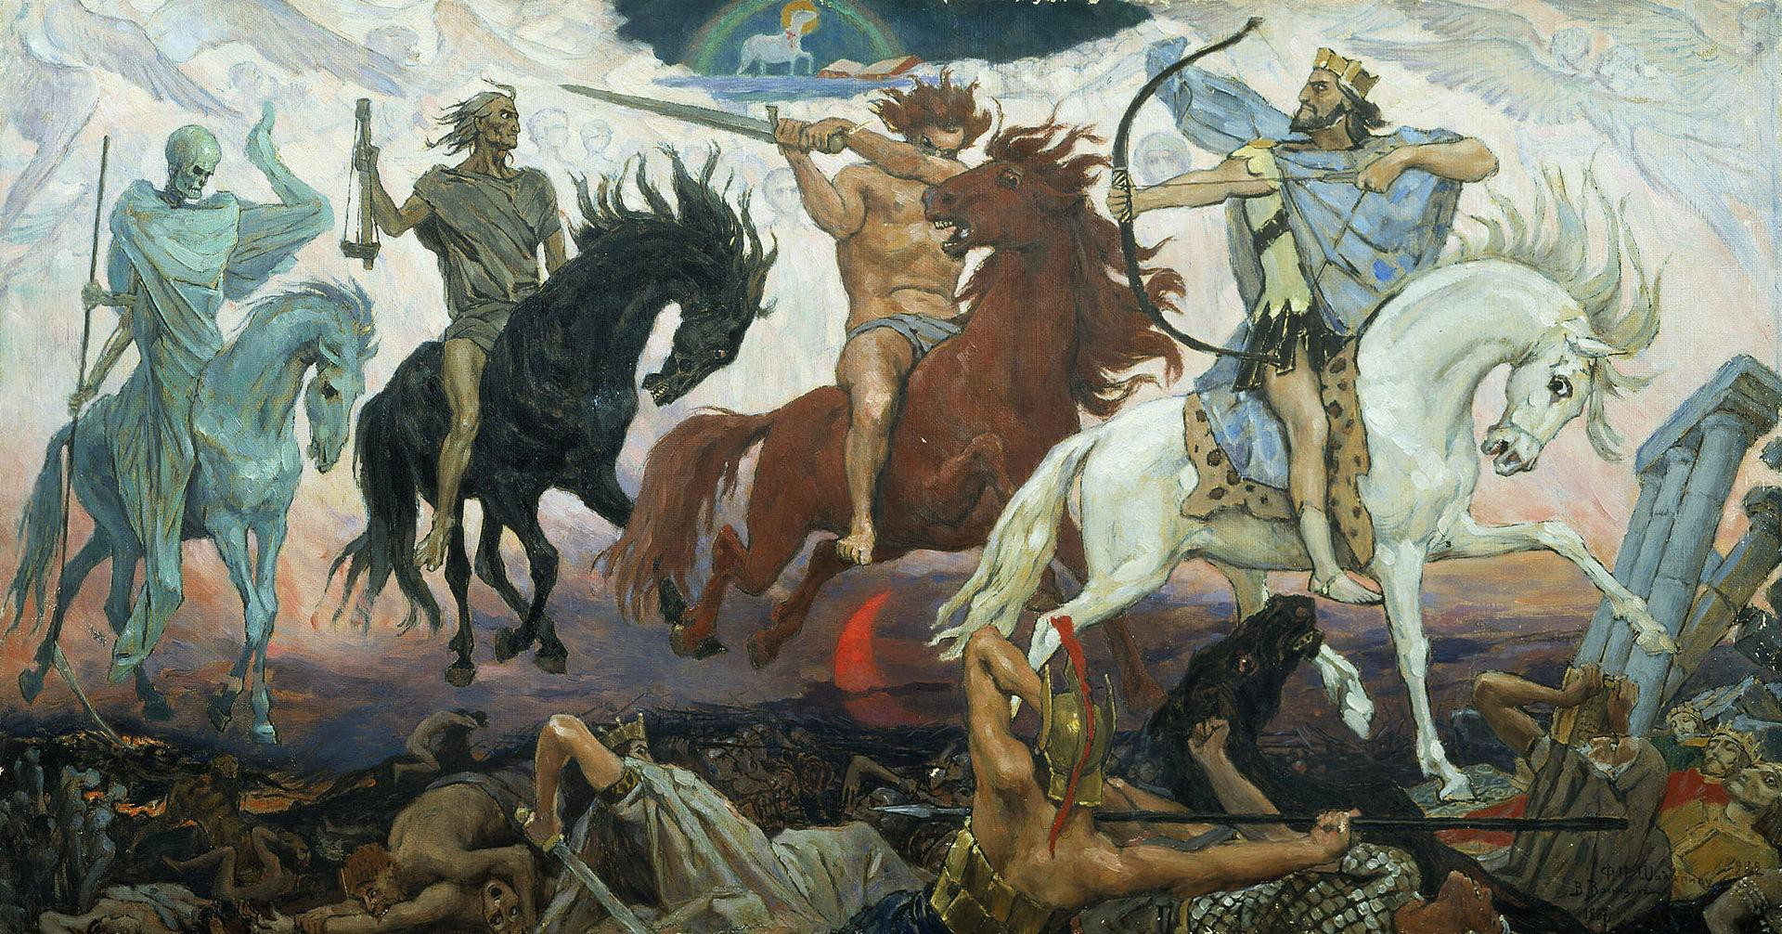

Four horsemen of ML failure
Data assumptions
Data snooping
Underfitting
Overfitting

Slide 27
Data assumptions
i.i.d
Identical: Data is drawn from the same data distribution
Independent: Data points independent from each other
Sampling/Selection bias
If i.i.d assumption is violated does learning work?
How can we overcome?

Slide 28
Data Snooping
Test data has informed the model selection
Generalization suffers
“If you want an unbiased assessment of your learning performance, you should keep a test set in a vault and never use it for learning in any way” Mostafa et al. Learning from data (book)

Slide 29
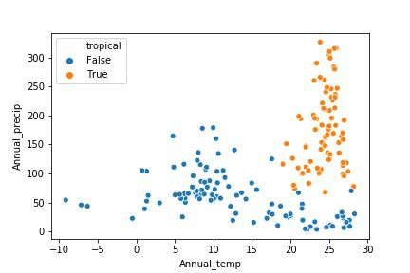
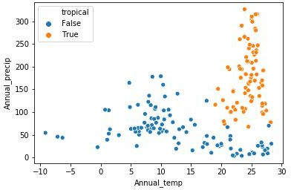
Underfitting & Overfitting

Slide 30
Underfitting & Overfitting
Underfitting
Appropriate capacity
Overfitting

Slide 31
Underfitting & Overfitting
Models are chosen based on training error
Test error ≥ Training error
Underfitting
Appropriate capacity
Overfitting

Slide 32
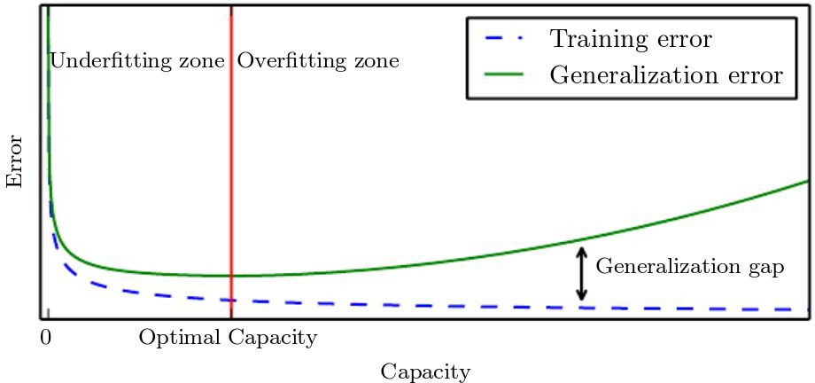
Handling overfitting
Representational capacity
Occam’s Razor: “The simplest model that fits the data is also the most plausible.”

Slide 33
Summary of Learning Principles
Data is not ideal
Lock away test data
Low generalization error is the Holy Grail of all ML
Model capacity is hard to decide, even with Occam’s Razor
Underfitting & Overfitting can hamper performance

Slide 34
A non-linear classifier

Slide 35
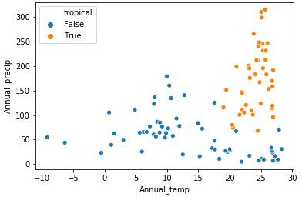
k-Nearest Neighbour Classification
What if data is not linearly separable?
What about multi-class classification?

Slide 36
k-Nearest Neighbour Classification
Non-parametric method
Based on neighbourhoods
Requires a notion of similarity
One of the simplest, yet effective methods
Multi-class classification

Slide 37
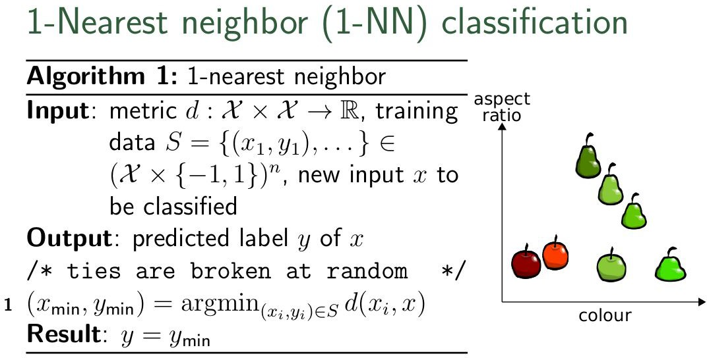
k-Nearest Neighbour Classification
Non-parametric method
Based on neighbourhoods
Requires a notion of similarity
One of the simplest, yet effective methods
Multi-class classification
How to choose k?

Slide 38
An unsupervised clustering algorithm

Slide 39
Unsupervised Learning: Clustering
We focus on k-Means clustering
Process of grouping similar objects together
Detecting patterns
Either based on similarity or features
Representing data at higher abstractions
Applications like image segmentation

Slide 40
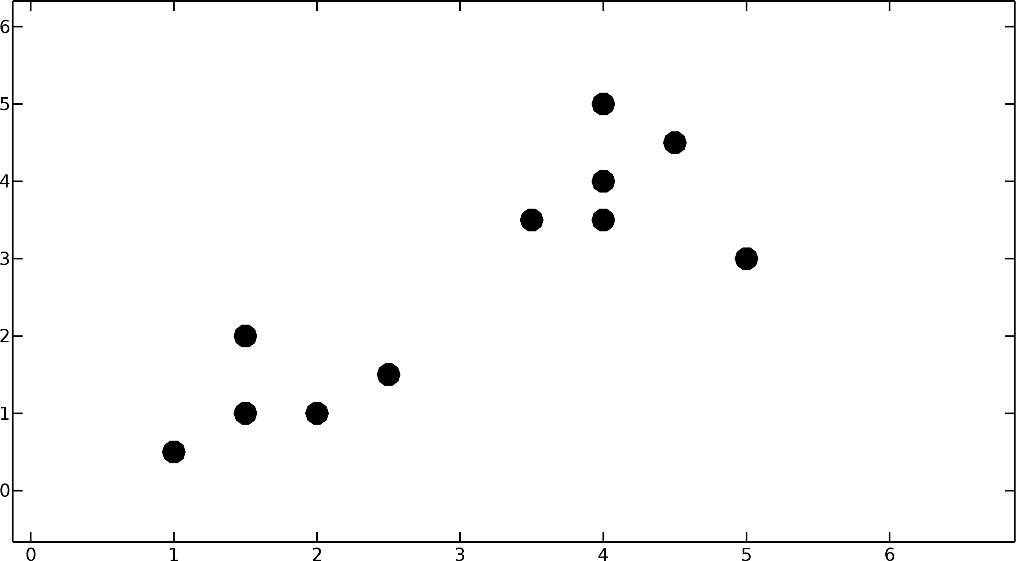
Toy example:

Slide 41
How would you cluster these points?
Think on these lines...
Measure of similarity
Number of clusters
Complexity

Slide 42
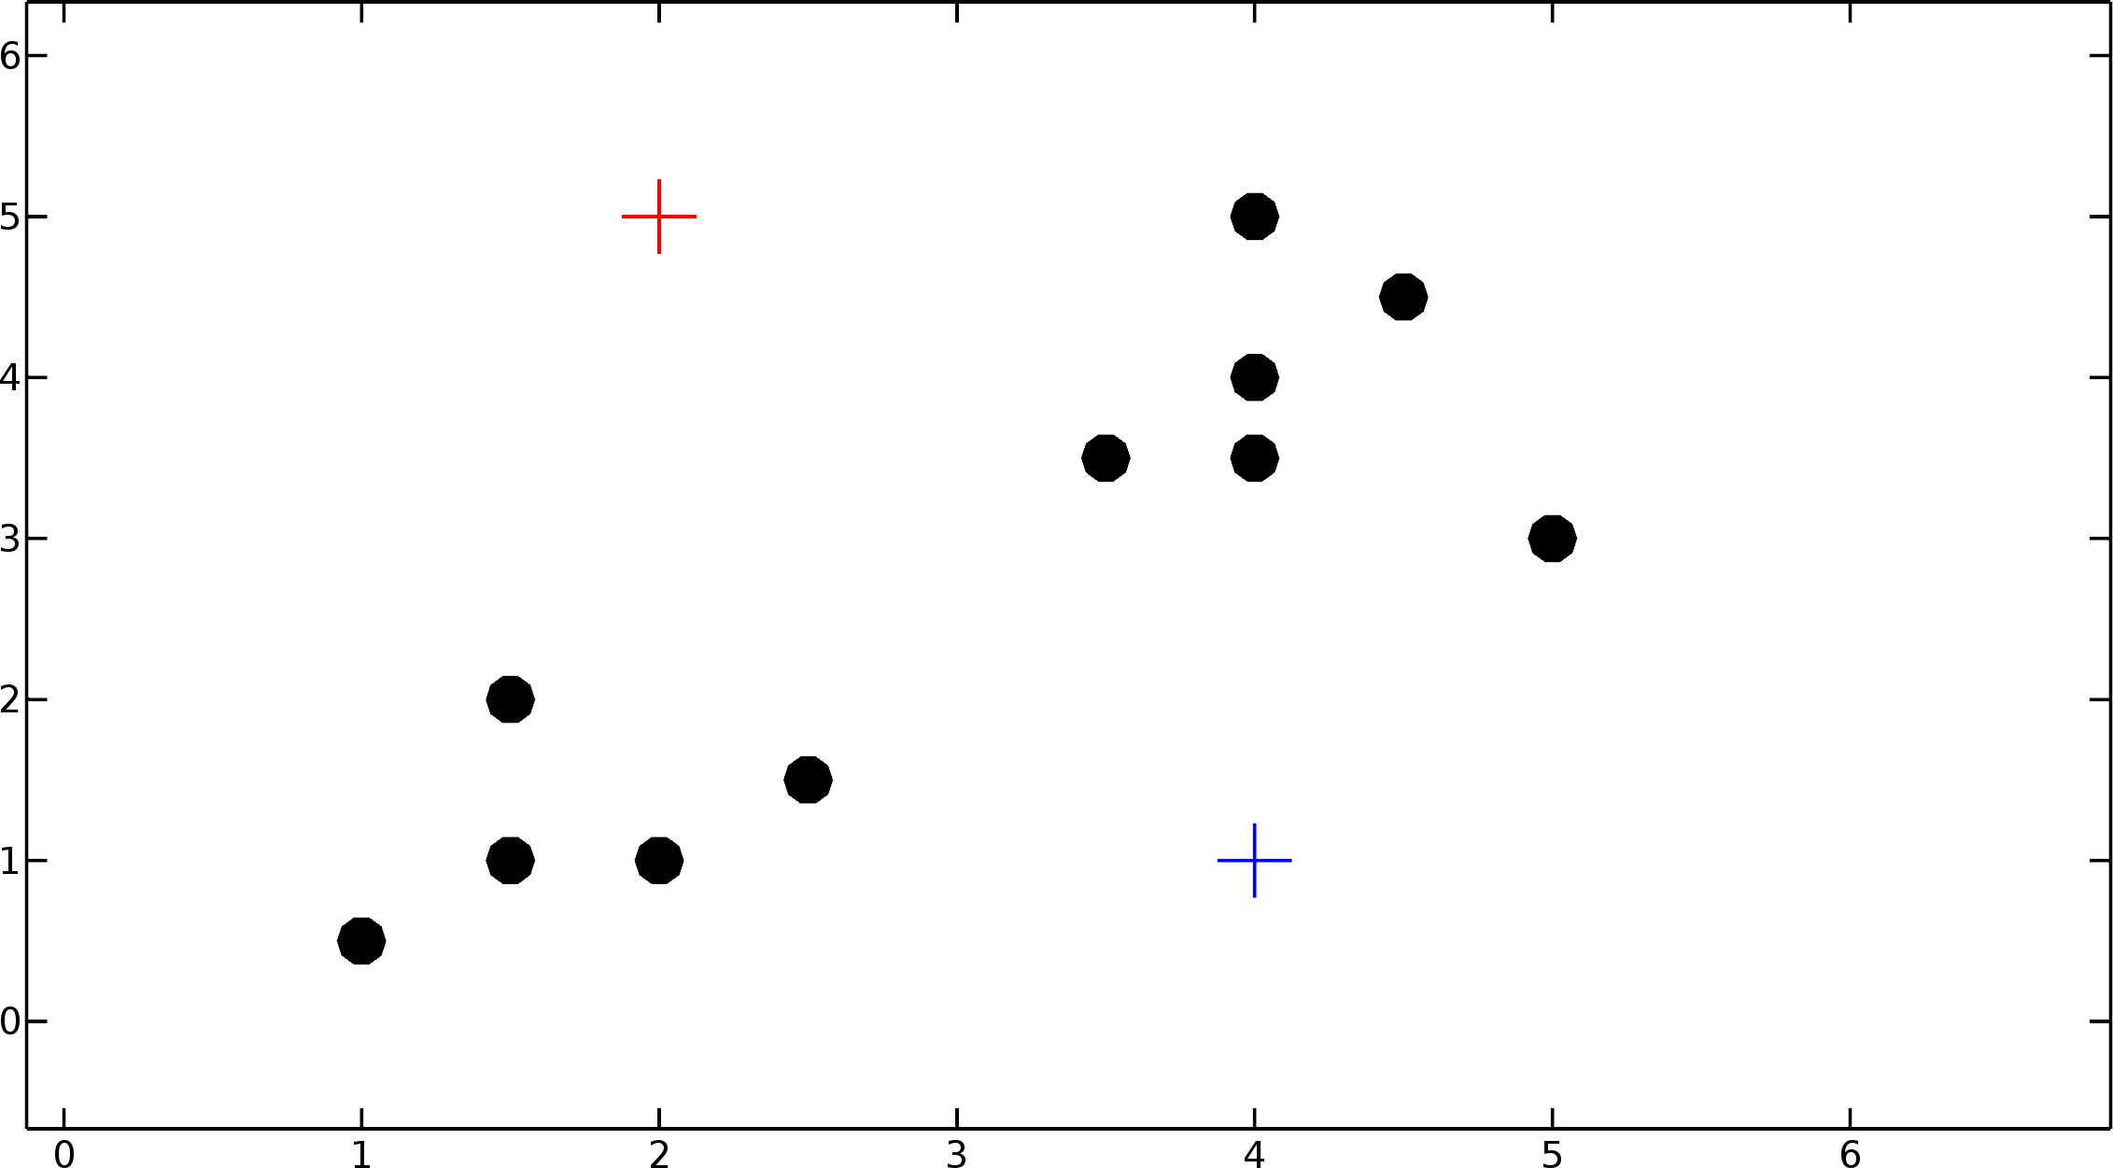
Initialize centroids, randomly!

Slide 43
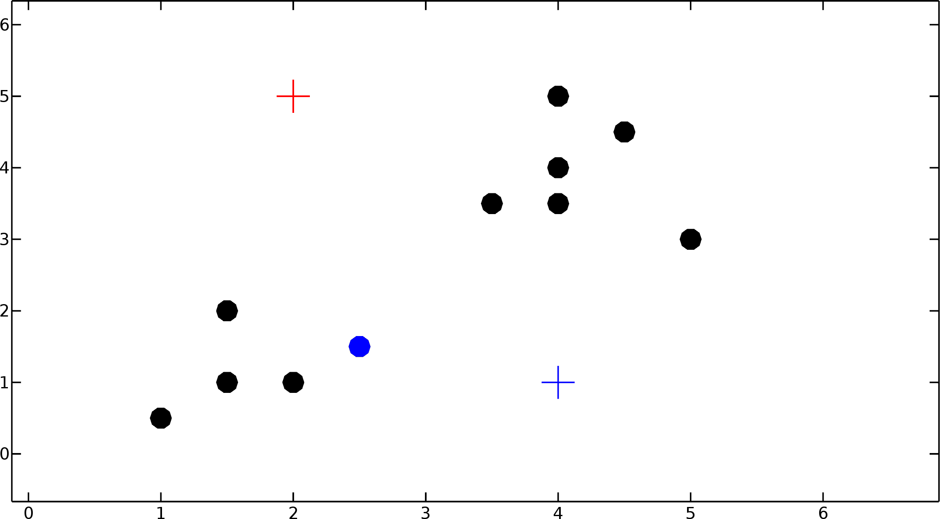
Assign points to nearest centroid!

Slide 44
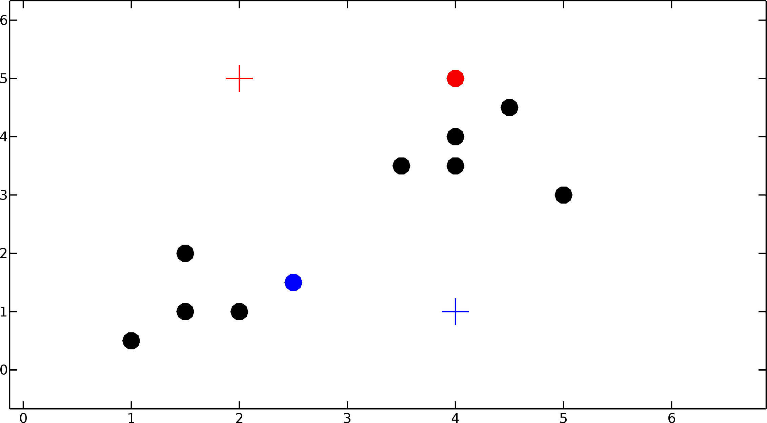
Assign points to nearest centroid!

Slide 45
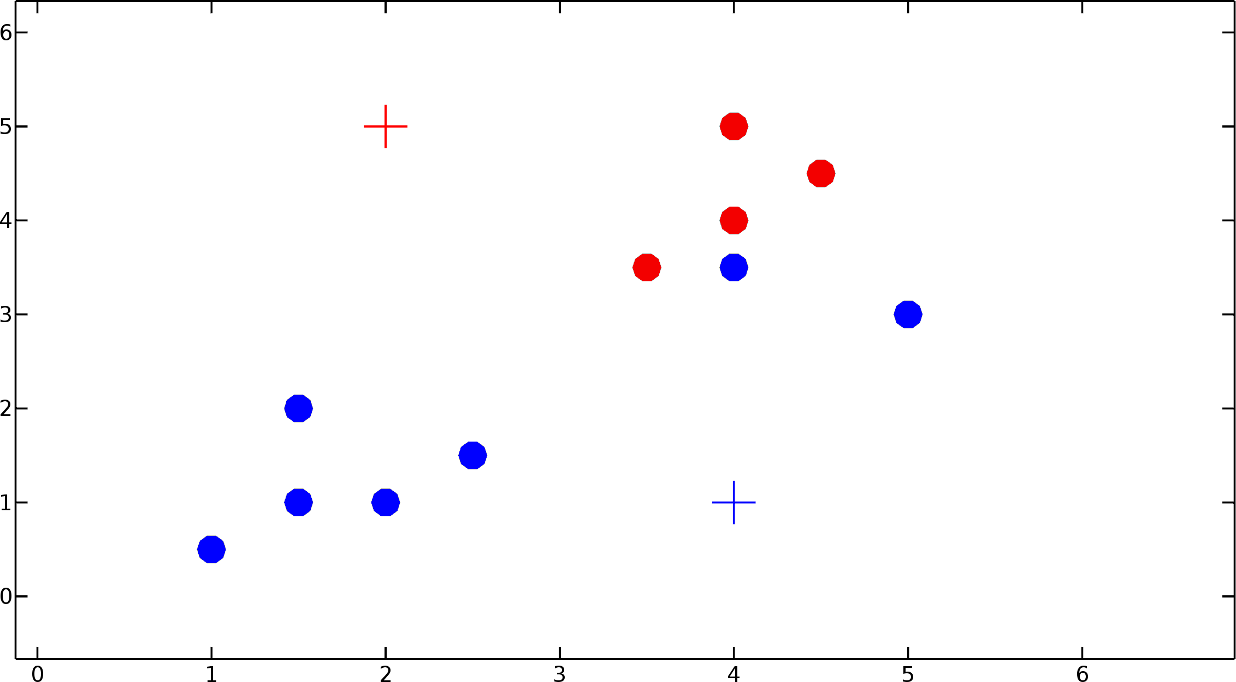
Assign points to nearest centroid!
u n i v e r s i t y o f c o p e n h a g e n

Slide 46
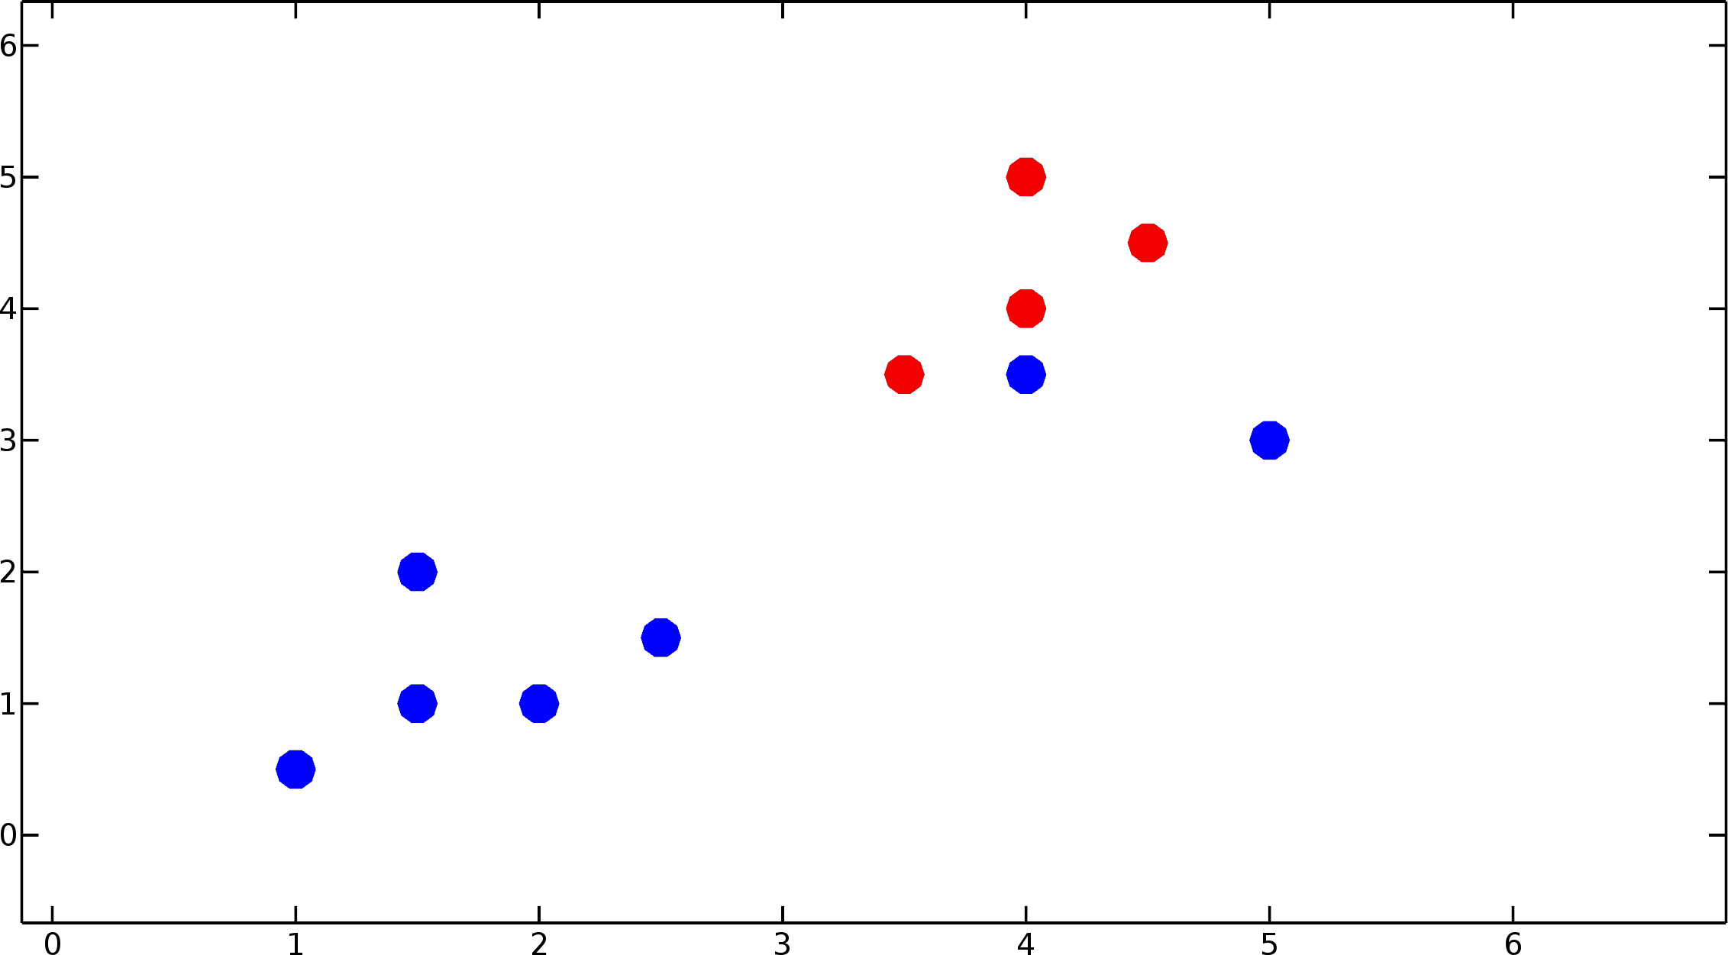
Recompute centroids!

Slide 47
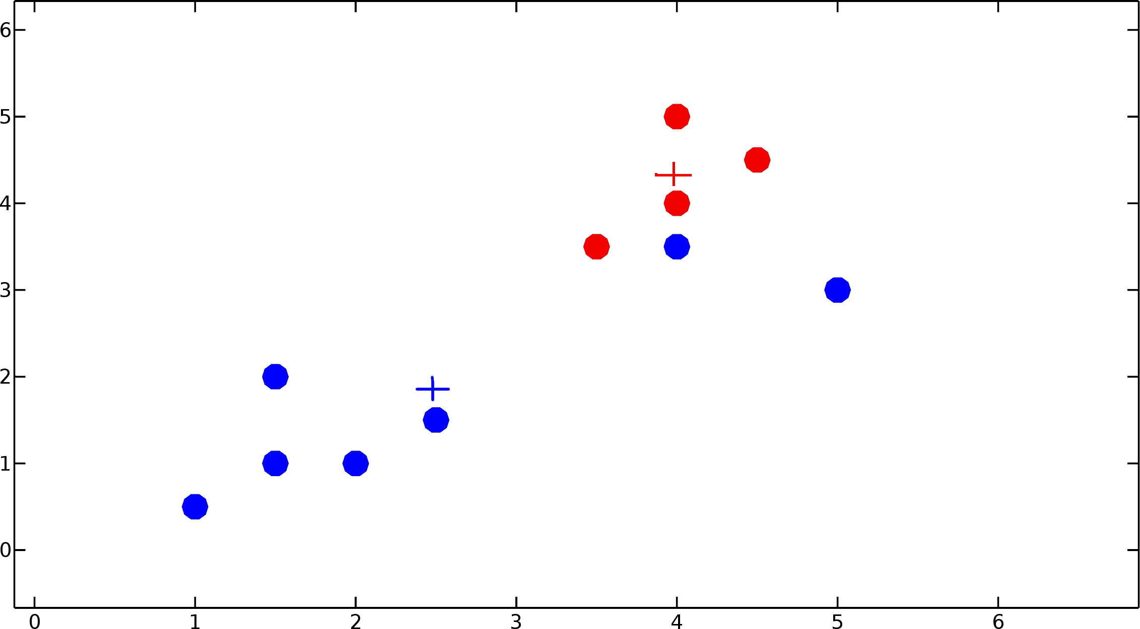
Recompute centroids!

Slide 48
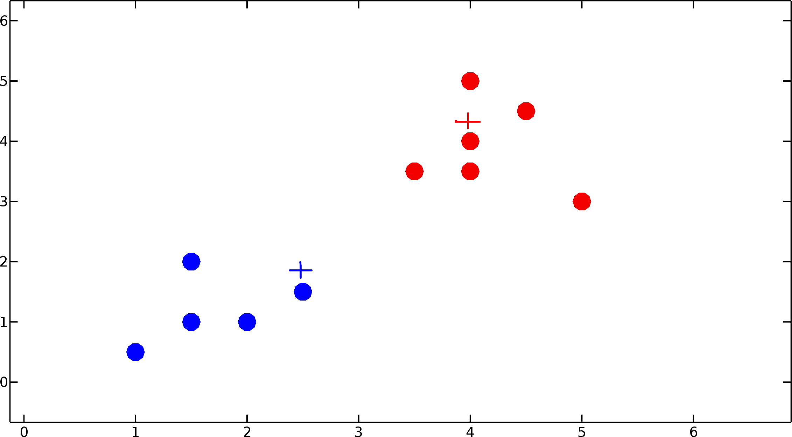
Iterate, until convergence!

Slide 49
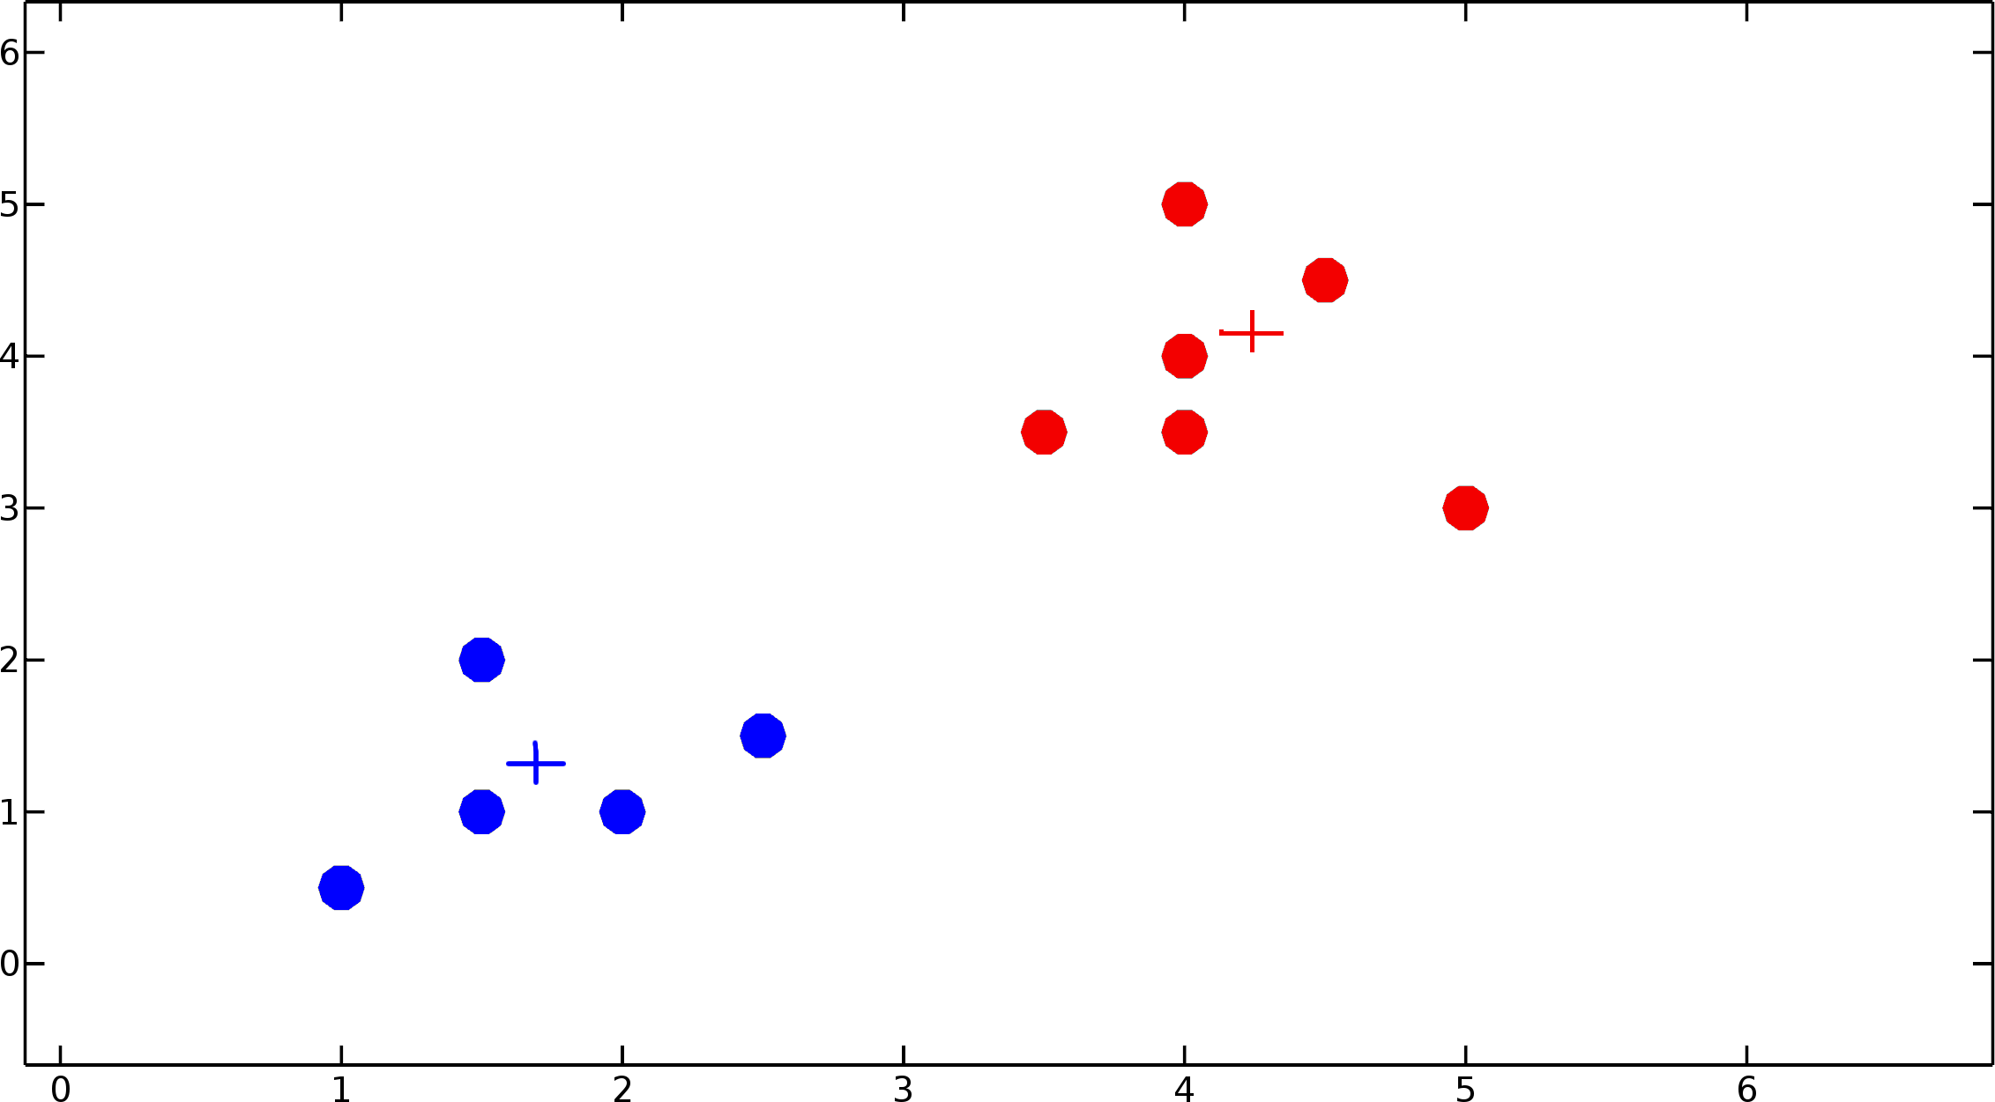
Iterate, until convergence!

Slide 50
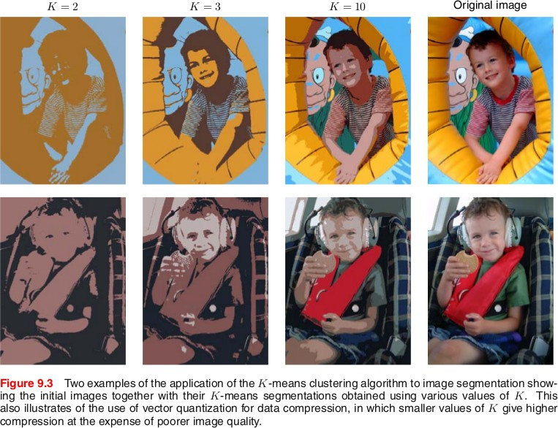
k-Means clustering based Image Segmentation
Figure from Christopher Bishop, PRML

Slide 51
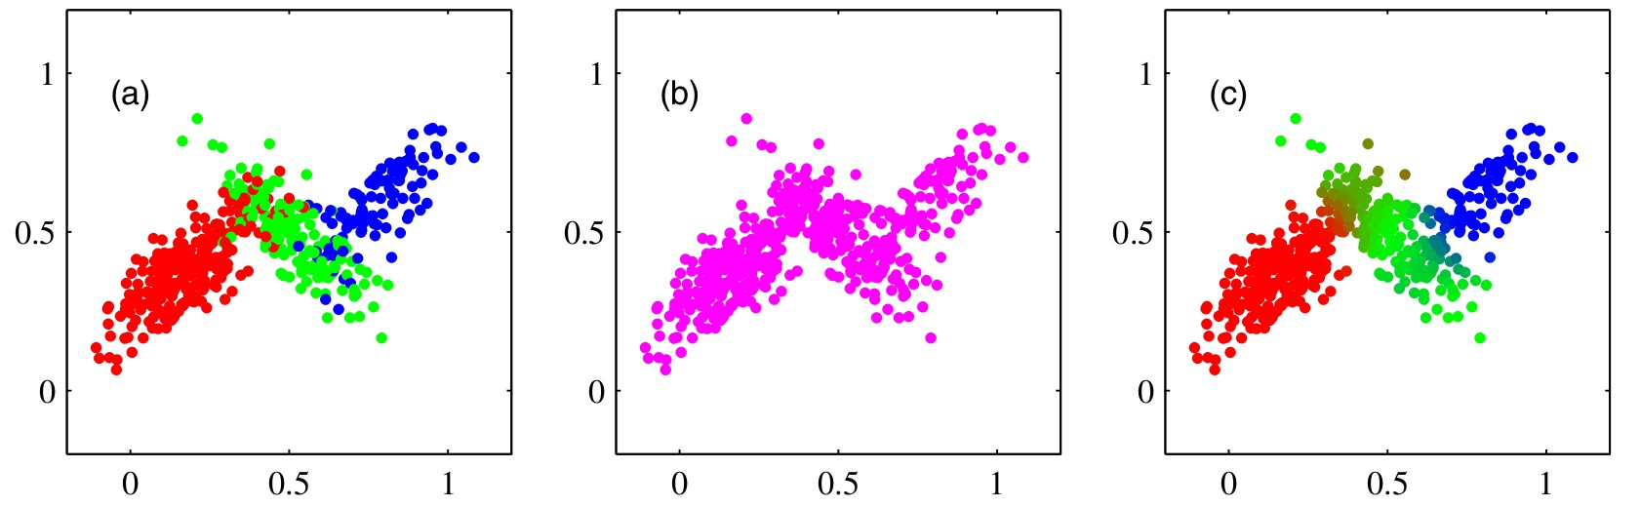
Summary: k-Means Clustering
+ Simple with good performance
+ Single hyperparameter
+ Cross validation for parameter selection
+ Flexibile similarity measures
+ Hard EM: Assigns hard labels
+ Powerful unsupervised method when used with PCA
- k has to be pre-selected; Sensitive to initialization
⁵Fig. 9.5 from Christopher Bishop, PRML
How to choose k?

Slide 52
Model Selection & Validation

Slide 53
Model Selection & Validation
How to avoid Overfitting
How to pick models based on training error

Slide 54
Validation Set comes to the rescue
Training
Test

Slide 55
Validation Set comes to the rescue
Training
Test
Training | Validation |  | Test

Slide 56
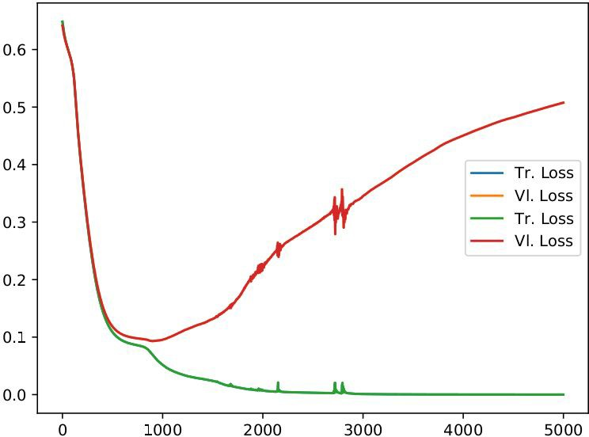
Validation Set comes to the rescue
Training data for training
Validation data for model selection
Hyper-parameters can be selected with it
Rule of thumb: 60-20-20
Consequences:
Reduction in training data
Computational overhead
Training | Validation |  | Test

Slide 57
Cross-validation gives more training data
All the data

Slide 58
Cross-validation gives more training data
All the data
Fold 0 Fold 1 Fold 2 | Fold 3
Train
Test

Slide 59
Cross-validation gives more training data
Train
All the data
Test
Fold 0
Fold 1
Fold 2
Fold 3
Fold 0
Fold 1
Fold 2
Fold 3
Fold 0
Fold 1
Fold 2
Fold 3
Fold 0
Fold 1
Fold 2
Fold 3

Slide 60
Summary
Models selection is not straightforward
Pick a class of models -> Tune hyper-parameters
Training data to select models
Generalization suffers if only based on training data
Many (equally better/worse) models to choose from
Cross validation to the rescue (?)
Hard to generalize
And, no free lunch

